Slide 1
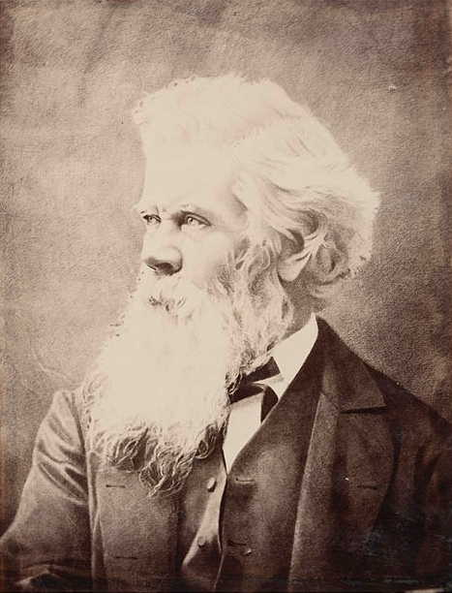
HENRY PARKES
Teacher Tip
Use slideshow mode.
Notes:
Who was Henry Parkes? This slideshow will provide us with an overview of the life of Henry Parkes and his role as a significant individual in leading Australia to Federation.

Slide 2
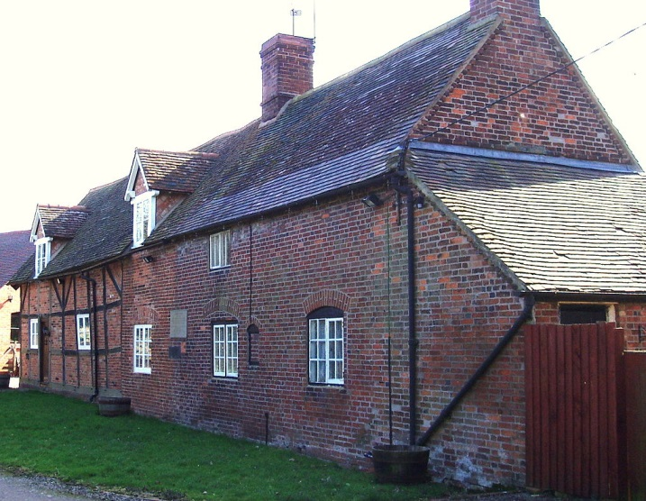
Early life
Born 27 May 1815 in England
1839 — migrated to Australia with his wife and child
Worked in many different jobs, but low wages did not appeal
Owned many businesses but went bankrupt several times
Birthplace in Canley, England
Notes:
(Click) Sir Henry Parkes was born on 27 May, 1815, in Canley, Warwickshire, in England. Brought up in a lower-class family with a father who was a farmer, he was the youngest of seven children and had very little formal education after the age of eight. (Click) At 24 years of age, Parkes migrated to Sydney in Australia from England with his wife, Clarinda, and child in 1839. While in Australia, (Click) he had many different jobs, such as working in a factory manufacturing iron goods, and as a farm labourer, but the low wages did not appeal to him. (Click) He also had many businesses but went bankrupt several times. Despite the limited education he received, Henry Parkes was a very clever man, and was determined to be successful.

Slide 3
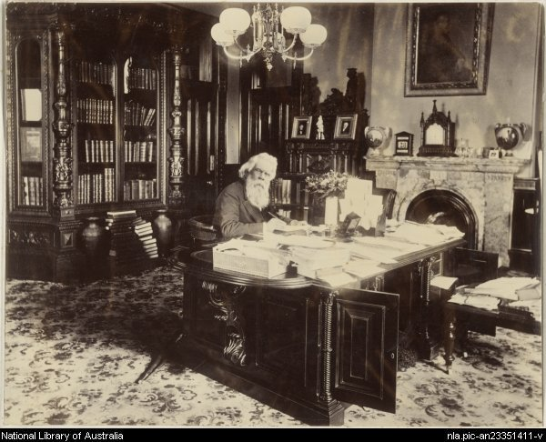
Career
Parkes became a writer and a poet, and was interested in political topics.
1850 — founded The Empire newspaper
1872 — Henry Parkes became Premier of New South Wales.
He served five terms as Premier in his career.
Henry Parkes at his desk while Premier
Notes:
(Click) He decided to become a writer and a poet, and was very interested in politics. (Click) By 1850, he was running a newspaper, The Empire, which called for more rights for the people. He was soon elected to parliament because of his support for democracy. (Click) In 1872, Parkes became the Premier of the colony of New South Wales, (Click) and went on to serve five terms.

Slide 4
Career highlights
1877 — awarded knighthood by Queen Victoria
Issues of colonial life were becoming more apparent.
1889 — delivered the ‘Tenterfield Oration’ calling for ‘a great national government for all Australians
THIS TABLET WAS UNVEILED BY
HIS ROYAL HIGHNESS THE DUKE OF GLOUCESTER
K.G., K.T., K.P.
GOVERNOR-GENERAL AND COMMANDER-IN-CHIEF OF THE COMMONWEALTH OF AUSTRALIA
ON THE 17TH OCTOBER, 1946
TO COMMEMORATE THAT ON 24TH OCTOBER, 1889
SIR HENRY PARKES
IN THIS HALL DELIVERED HIS
FAMOUS TENTERFIELD SPEECH
WHICH SET IN MOTION THE POPULAR
MOVEMENT RESULTING IN
AUSTRALIAN FEDERATION
1ST JANUARY 1901
The text on a plaque commemorating the Tenterfield Speech
Notes:
(Click) In 1877, Henry Parkes was awarded a knighthood by Queen Victoria. From this point forward, he was to be officially acknowledged as Sir Henry Parkes. During his time as Premier, (Click) he became frustrated with life in the colonies and the way things such as different tariffs, rail, transport, land laws and Chinese immigration in the colonies affected politics and business. Convinced the colonies would be stronger if they united, (Click) he delivered a speech in Tenterfield, New South Wales in 1889 that came to be known as the ‘Tenterfield Oration’. (Click) In the speech, he called for a Federal Convention to discuss the idea of a national government for Australia. Sir Henry Parkes’s ‘Tenterfield Oration’ created enthusiasm in the colonies for the benefits that a federated Australia would bring.

Slide 5
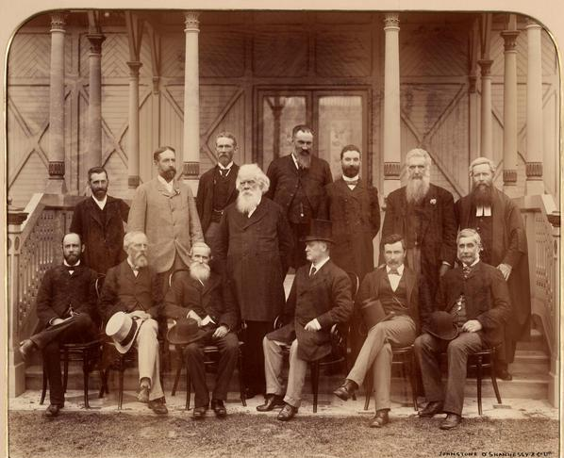
Career highlights
1890 — Australasian Federation Conference held in Melbourne
1891 — draft constitution written at the Australasian Federation Convention, Sydney
1893 — Sir Henry Parkes unable to attend Corowa Conference due to illness
Henry Parkes with the Members of the Australasian Federation Conference, 1890
Notes:
(Click) A meeting, which was called the Australasian Federation Conference, was held in Melbourne in 1890. This was a very important event, as it was the first time that premiers from each colony met to discuss whether they should federate. Having agreed that Federation was a good idea, another meeting was held in Sydney the following year, (Click) which was called the National Australasian Federation Convention. Representatives from the six Australian colonies and New Zealand met to draft the Australian Constitution, which would outline how Australia would federate. It’s important to note that New Zealand eventually opted out of the Federation process, stating too many differences with the Australian colonies. Sir Henry Parkes spoke of ‘one people, one destiny’, and of fostering a national Australian identity. A series of meetings and conferences to discuss the prospect of Australia federating followed after this. The Corowa Conference held in NSW in 1893 was one of the most significant events during this time. We will explore this in further detail in the next lesson. (Click) Unfortunately, Parkes was too ill to attend.

Slide 6
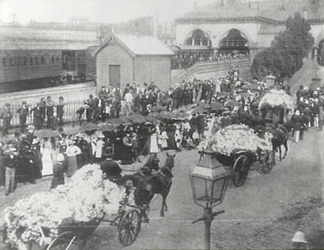
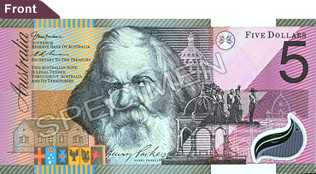
‘Father of Federation’
Died 27 April, 1896
Federation achieved four years after his death
Termed the ‘Father of Federation’ for his significant contribution in leading Australia towards Federation
Sir Henry Parkes’s funeral
Commemorated on stamps and currency
Notes:
(Click) Sir Henry Parkes did not live to see his dream of a federated Australia realised. He was 81 years old when he died on 27 April 1896, four years before Federation in 1901. (Click) Many believe that Parkes’ speech at Tenterfield provided the momentum that led to Australia becoming a nation. He made a significant contribution to the shaping of our nation, and was one of the most influential advocates of Federation for Australia. (Click) For this reason, he was known, and is still known today, as the ‘Father of Federation’ (Click) and has been commemorated with his image appearing on items such as stamps and Australian currency.

Slide 7
Attributions
Slide 1:
Sir Henry Parkes, Mitchell Library, State Library of New South Wales – PX*D 624/33
Slide 2:
Slater, A., Henry Parkes’ home, 2008, https://commons.wikimedia.org/wiki/File:Henry_Parkes_home.jpg CC-BY-SA 3.0 creativecommons.org/licenses/by/3.0/
Slide 3:
Sir Henry Parkes at his desk in the Office of the Colonial Secretary, Sydney 1891, National Library of Australia, http://nla.gov.au/nla.pic-an23351411
Slide 4:
Plaque text from photograph on Tenterfield Speech (Monument Australia) http://monumentaustralia.org.au/australian_monument/display/23427
Slide 5:
The Australasian Federation Conference, Melbourne, 1890, National Library of Australia http://nla.gov.au/nla.pic-an14292110
Slide 6:
Sir Henry Parkes - Funeral Cortege, 1896, Blue Mountains Library ID HS0\HS0452 http://www.photosau.com.au/BlueMountains/scripts/ExtSearch.asp?SearchTerm=HS0452
Australian 5 dollar note http://en.wikipedia.org/wiki/File:Australian_5note_front_(new).jpg
All other images © DET

